Slide 1








Time-to-Adapt (TTA)
Mohsen Mosayebiª, Michel Fathi^{b,*}, Mehrnaz Khalaj Hedayatiª, and Dmitry Ivanov ^{c}
ªGeorgia College and State University, USA; ^{b}University of North Texas, USA; ^{c}Berlin School of Economics and Law, Germany

Slide 2

Introduction
Mass customization refers to the ability to produce personalized products or services in large quantities and at a reasonable cost by utilizing adaptable processes¹.
In this study we analyze the disruptions in mass customization companies. We observed the strategy of the manufacturer improving the capability of adaptation.
Our analysis will detail the timing of various adaptations and modifications, including part design modification, manufacturing process changes, line rebalancing, and rescheduling, among others, that affect the disruption period.
https://www.google.com/url?sa=i&url=https%3A%2F%2Fcleverism.com%2Fmass-customization-what-why-how%2F&psig=AOvVaw2MxMunbd _2NMsIkiyR_68w&ust=1699901586768000&source=images&cd=vfe&opi=89978449&ved=0CBIQjRxqFwoTCNjStImRv4IDFQAAAAAdAAAAABAg

Slide 3

Motivation
The motivation for this paper was inspired by Simch-Levi et al. (2015, 2018), who defined Time-to-Survive (TTS) as an indicator of the maximum time a manufacturer can operate without performance degradation.
Another inspiration came from Miklovic et al. (2010), who discussed the Cisco risk management system, supplier audits, and the identification of Time-to-Recover (TTR), which refers to the time needed to restore full operational capacity after a disruption.

Slide 4


Motivation

Slide 5
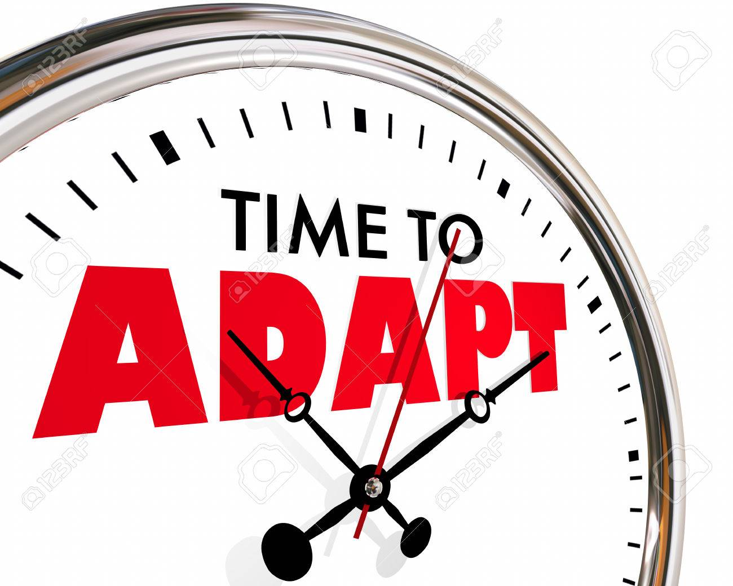
Definition
Time-to-Adapt is an indicator for the time between the start of the disruption and the first action implemented, which lets the manufacturer continue production during the disruption.

Slide 6
Literature Review
Category of research | References
Causes and Effects of Disruptions | Dolgui, Ivanov, and Sokolov (2018) ; Queiroz et al. (2022); Ivanov (2023) ; Ivanov and Dolgui (2022a)
Strategy Analysis and Post-Pandemic Adaptation | Craighead, Ketchen Jr, and Darby (2020); Ivanov (2021); Ardolino et al. (2022); Bode and Macdonald (2017); Govindan et al. (2023)
Mitigation Strategies for Manufacturers | Miklovic and Witty (2010); Simchi-Levi, Wang, and Wei (2018); Simchi-Levi, Schmidt, and Wei 2014; Simchi-Levi et al. 2015.
Supply Chain Disruption and Resilience | Chopra, Sodhi, and L¨ucker (2021) ; Ivanov et al. (2023); Aldrighetti, Battini, and Ivanov (2023); Ivanov and Dolgui (2022b);
The effect of disruption on mass production and mass customization manufacturers | Ahmad, Schroeder, and Mallick (2010); Aldrighetti et al. (2021b); Da Silveira, Borenstein, and Fogliatto (2001); Eastwood (1996)

Slide 7



Method
Case sturdy:
Observations
Mathematical Modeling

Slide 8
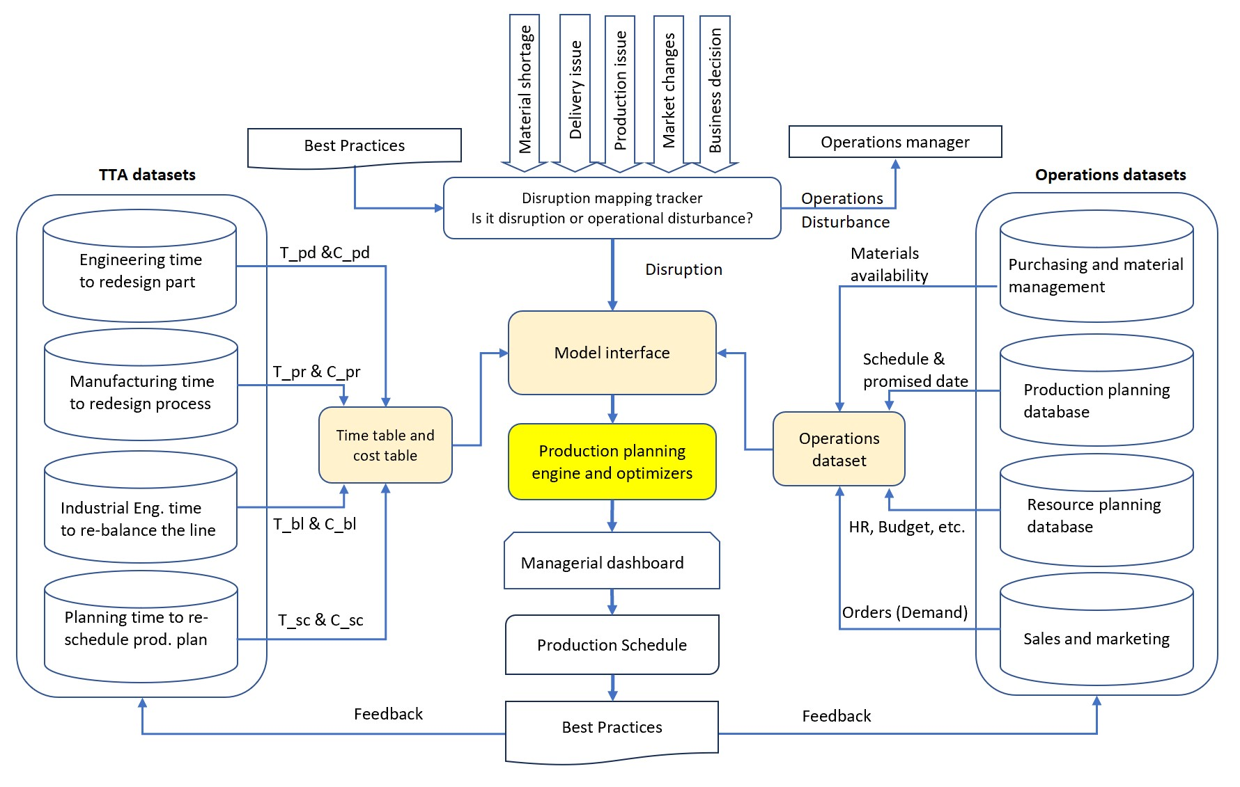
Production Planning Model

Slide 9
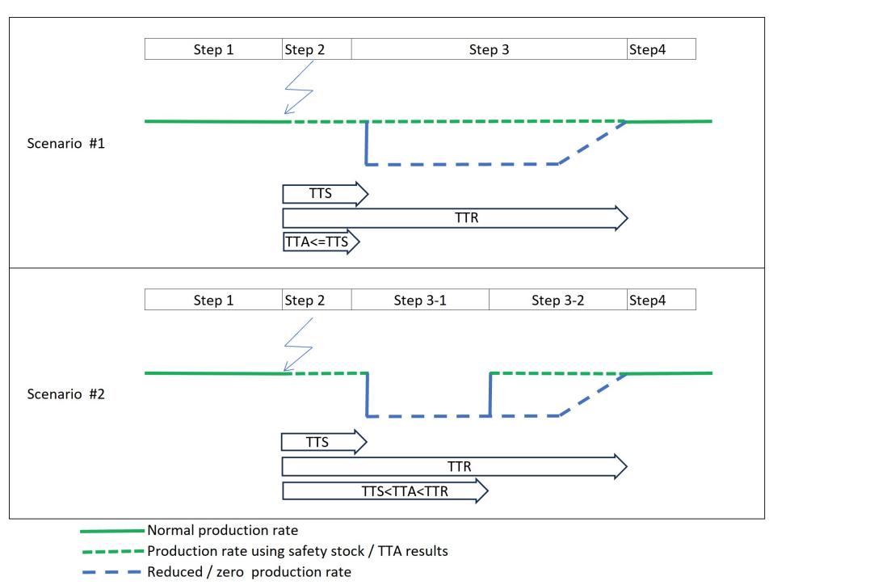
Outcome Comparison

Slide 10

Conclusion
This paper defines Time-to-Adapt (TTA) as an indicator to measure the adaptation period that shows the capability of the manufacturer to mitigate the effect of disruption by adding the mindset of internal manufacturer actions parallel to external supply chain actions. Using TTA also affects business strategy by focusing on empowering inside controllable factors simultaneously with external factors.
Our findings underscore the importance of incorporating TTA, TTS, and TTR into the strategic planning of manufacturers. In addition, using TTA and focusing on internal capabilities such as design modification, process adjustments, line balancing, and production scheduling, manufacturers can continue operations during disruptions and enhance their overall supply chain resilience.

Slide 11


